Slide 1
Introduction to Applied Bioinformatics - day2
KAUST Bioinformatics platform | KAUST

Slide 2
Recap of day1
Bioinformatics is a multidisciplinary field (bio, cs, stat)
It covers various domains and applications
Linux command line (pwd, mkdir, ls, cd, nano, wc, etc)
File formats (fasta, fastq)
Seqkit for sequence file overview
Tools: Linux commands, seqkit

Slide 3
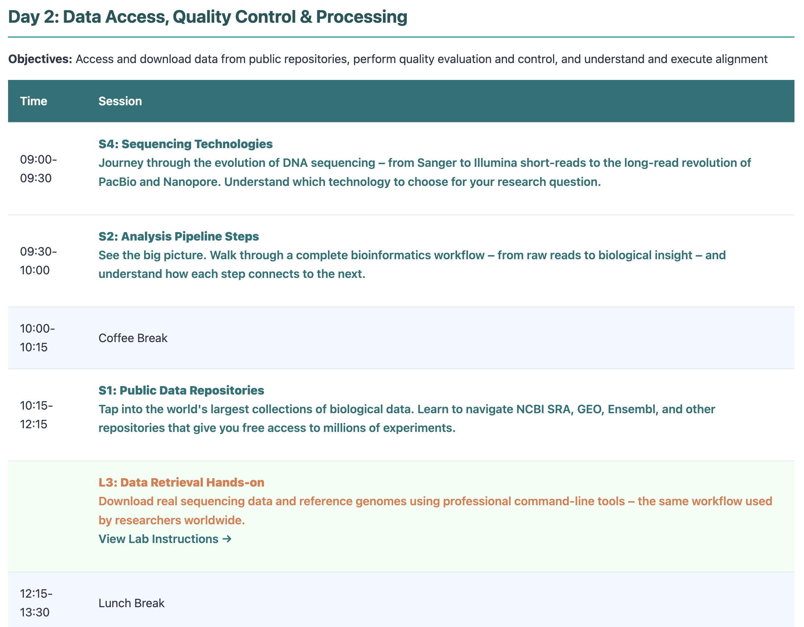
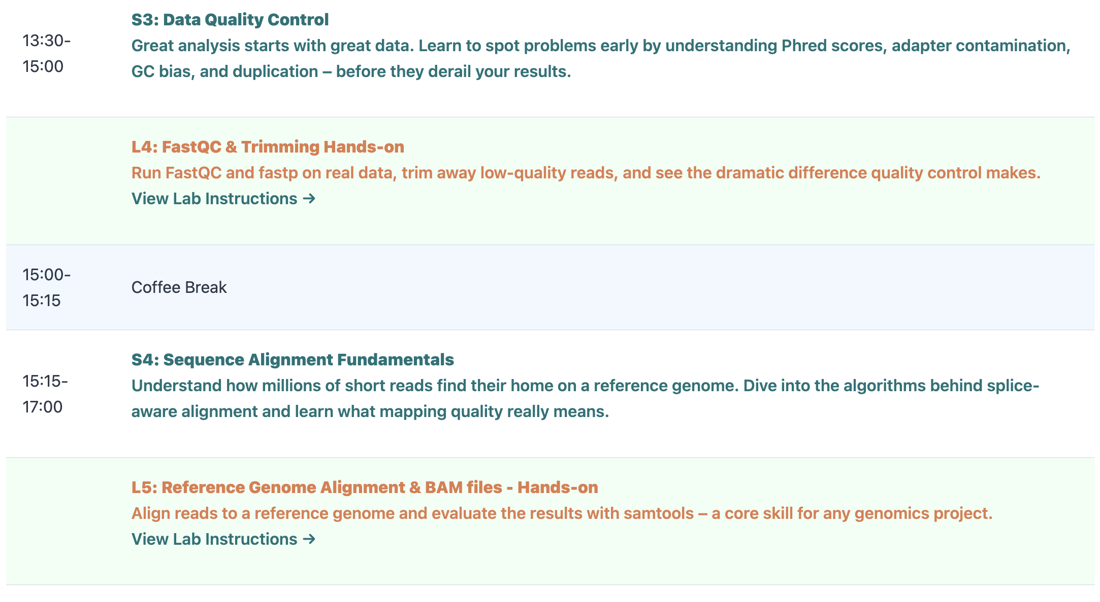
Agenda for day2
Tools: fastqc, fastp, star, samtools

Slide 4

Sequencing Technologies

Slide 5
A Typical Bioinformatics Workflow
1
2
3
4
Question
Data Acquisition
Quality Control
Processing
Define a clear, testable biological question
Obtain raw data (sequencing, public databases, experiments)
Assess data quality, trim adapters, filter low-quality reads
Alignment, assembly, quantification, variant calling
5
6
7
8
Analysis
Interpretation
Visualization
Reporting
Statistical testing, clustering, differential expression, enrichment
Biological context, pathway analysis, literature integration
Plots, heatmaps, genome browsers, interactive dashboards
Reproducible documentation, data deposition, publication
KAUST Bioinformatics Platform

Slide 6
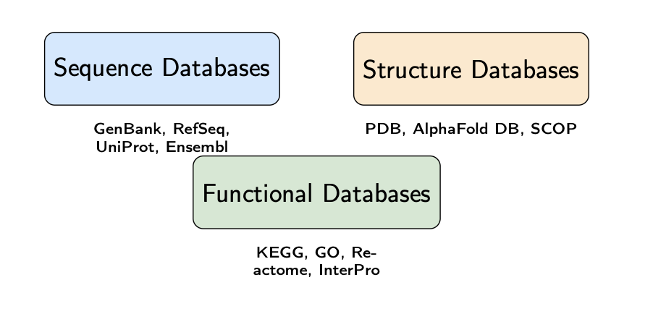
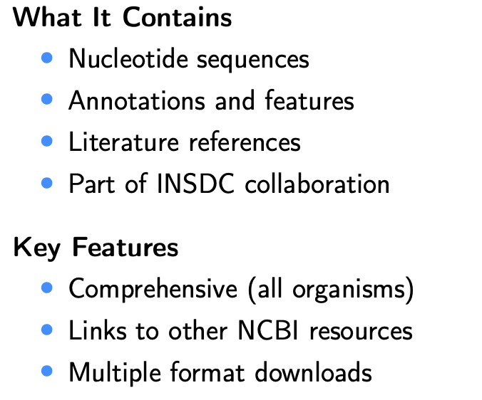
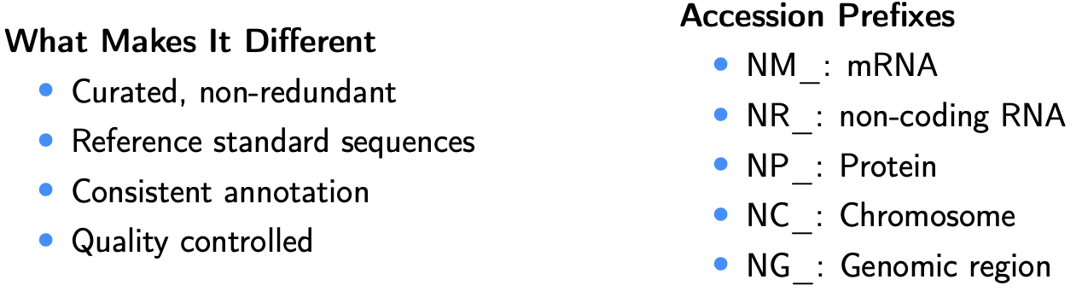
Biological resources
NCBI
Genbank: https://www.ncbi.nlm.nih.gov/genbank/
an annotated collection of all publicly available DNA sequences
Ensembl: https://www.ensembl.org
What It Contains
• Genome assemblies
• Gene annotations
• Comparative genomics
• Variation data
• Regulatory features
Useful For
• Downloading reference genomes
• Gene/transcript information
• Ortholog identification
• Variant annotation (VEP)
BioMart tool for advanced queries
refseq: https://www.ncbi.nlm.nih.gov/refseq/
KAUST Bioinformatics Platform

Slide 7
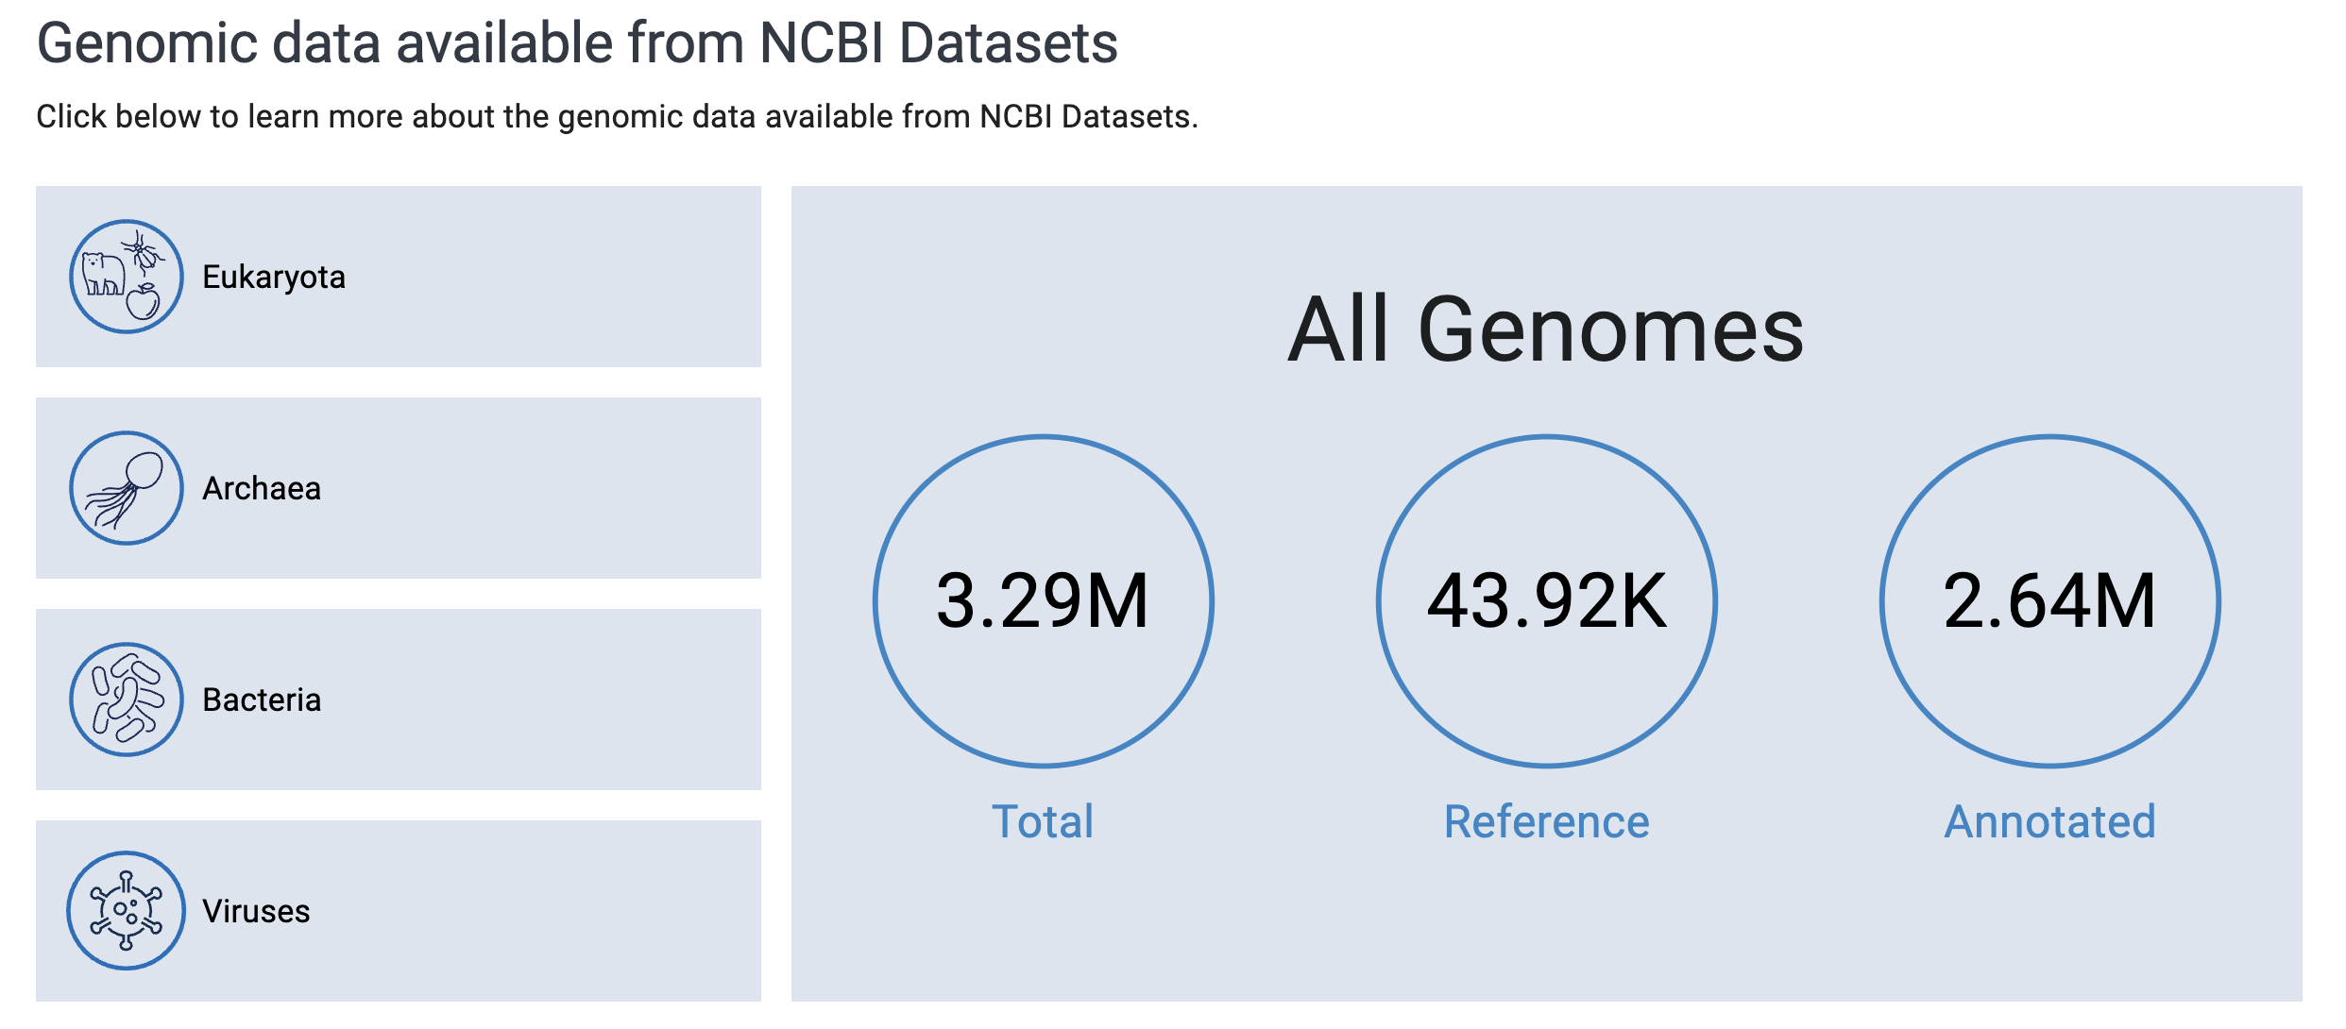
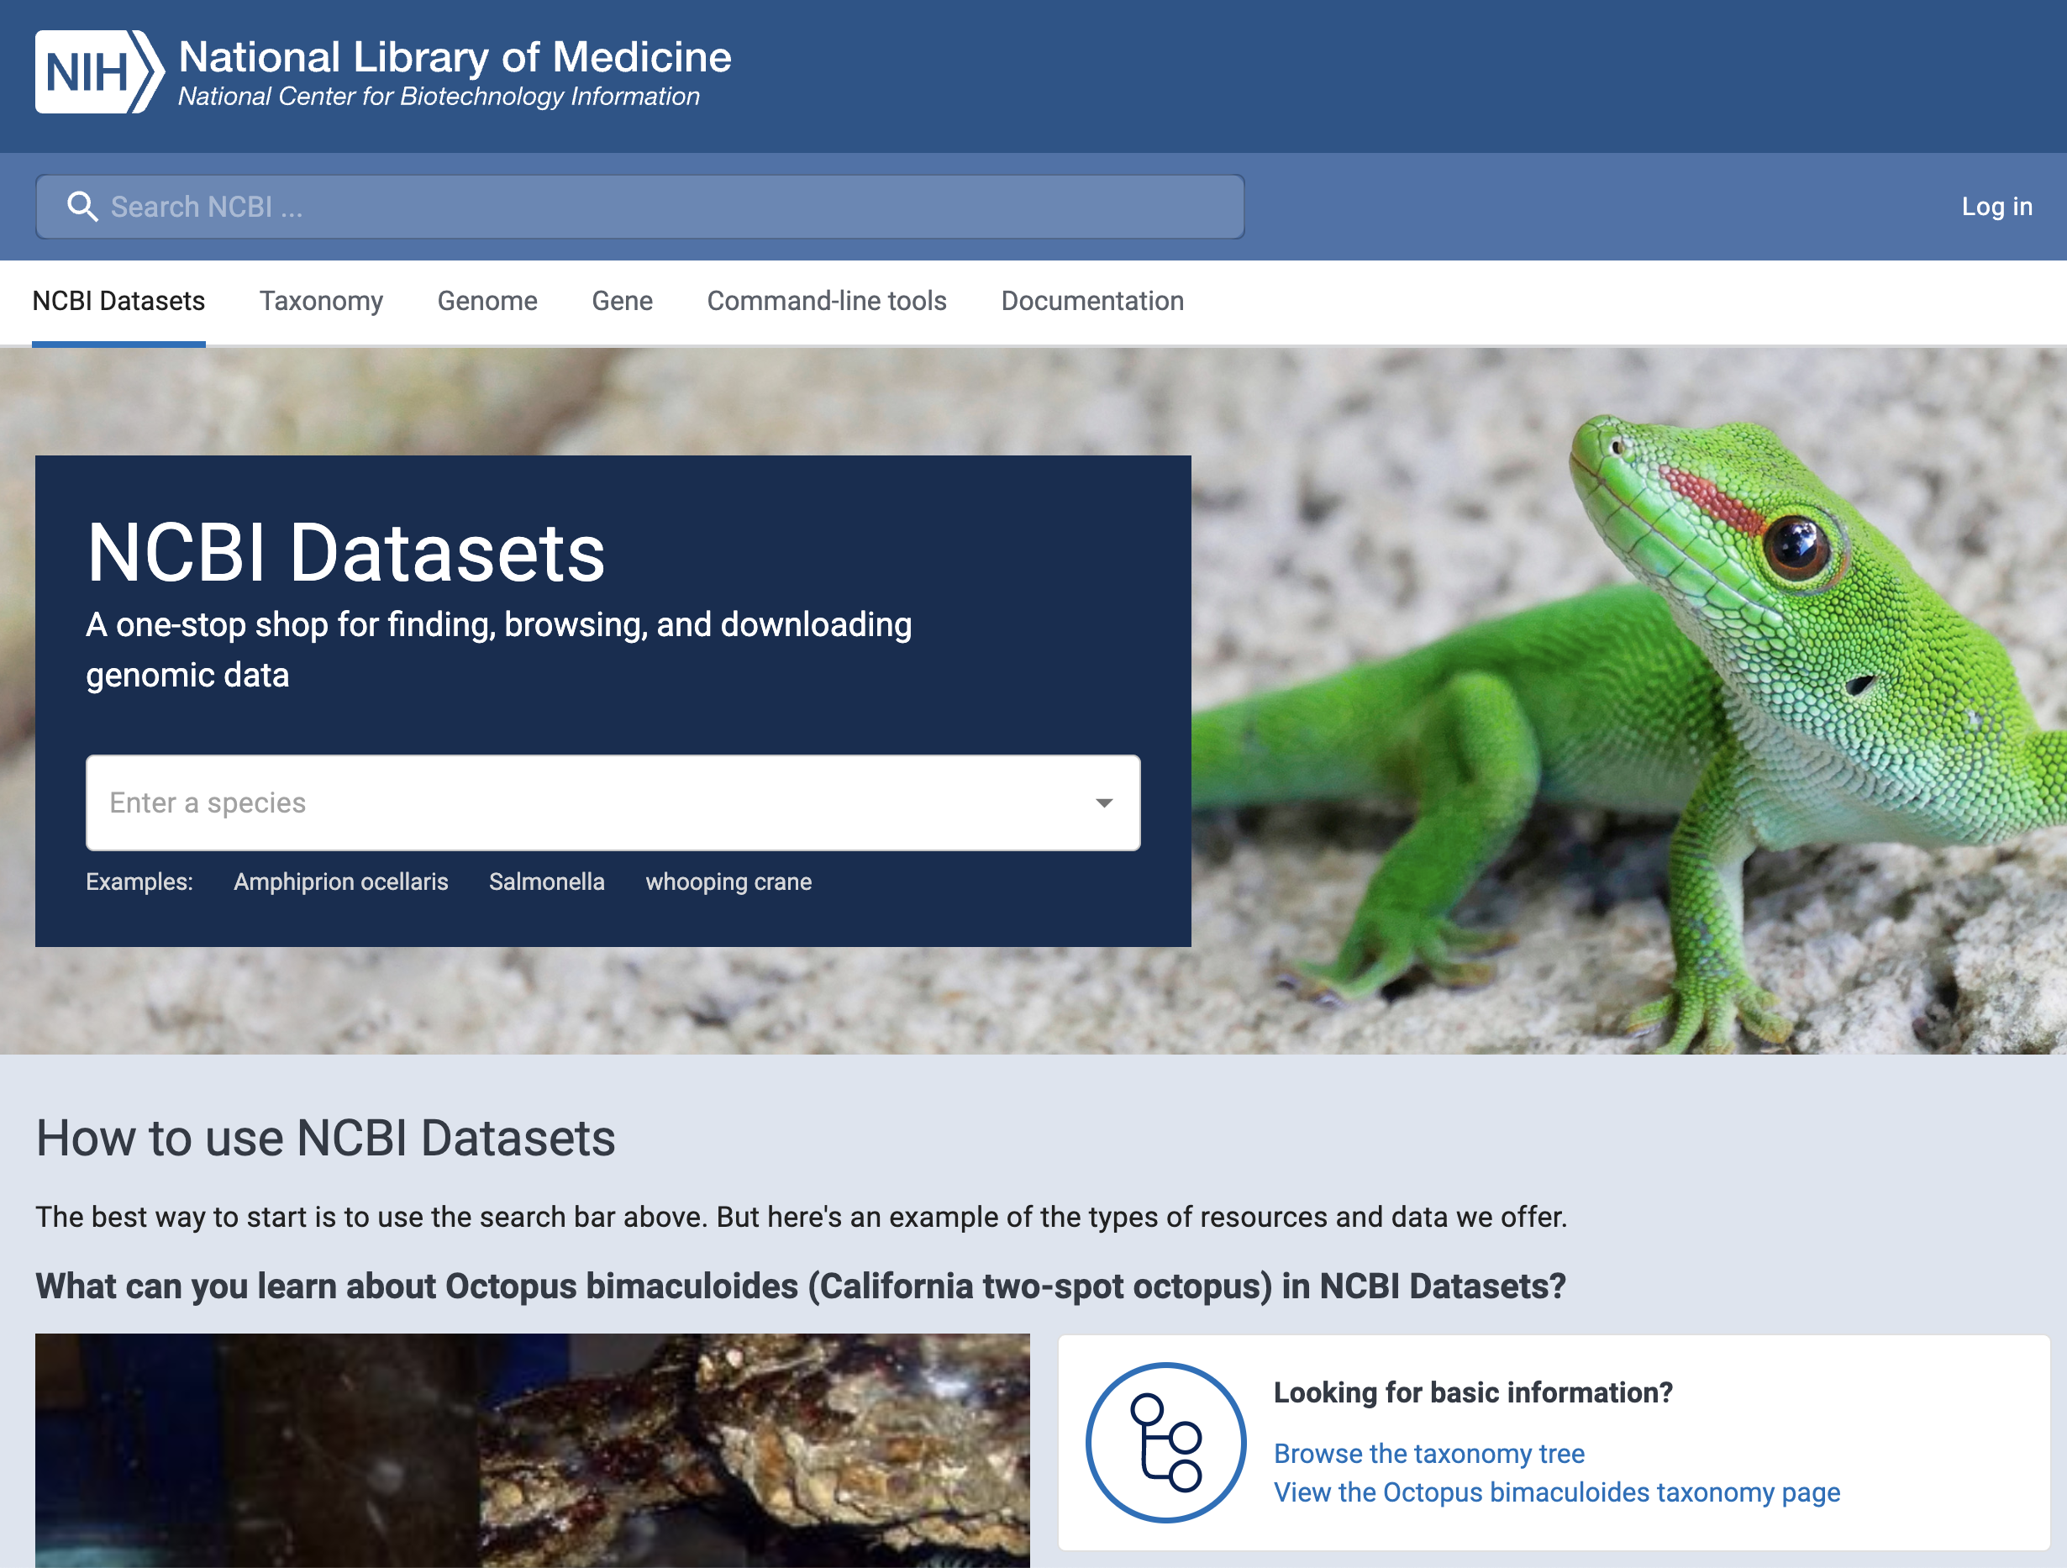
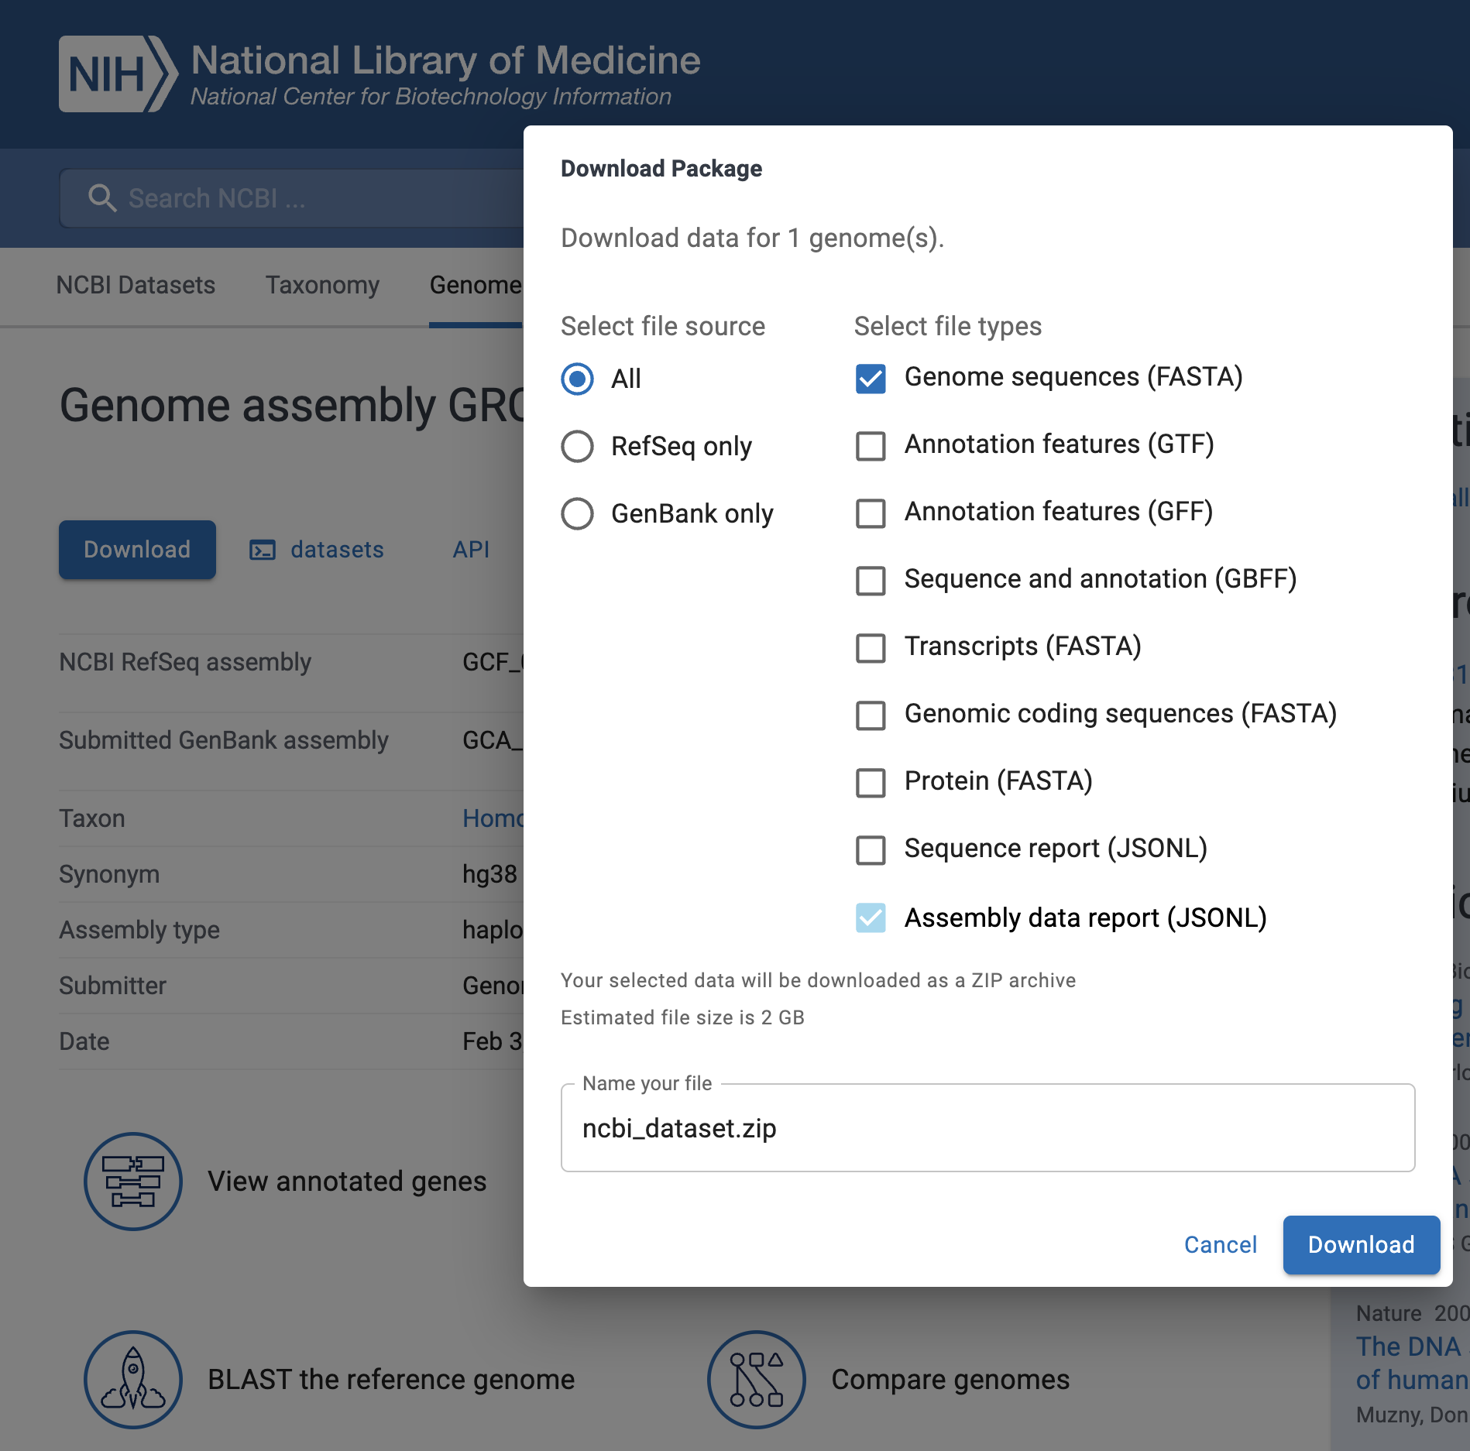
Open NCBI: https://www.ncbi.nlm.nih.gov/datasets/

Slide 8
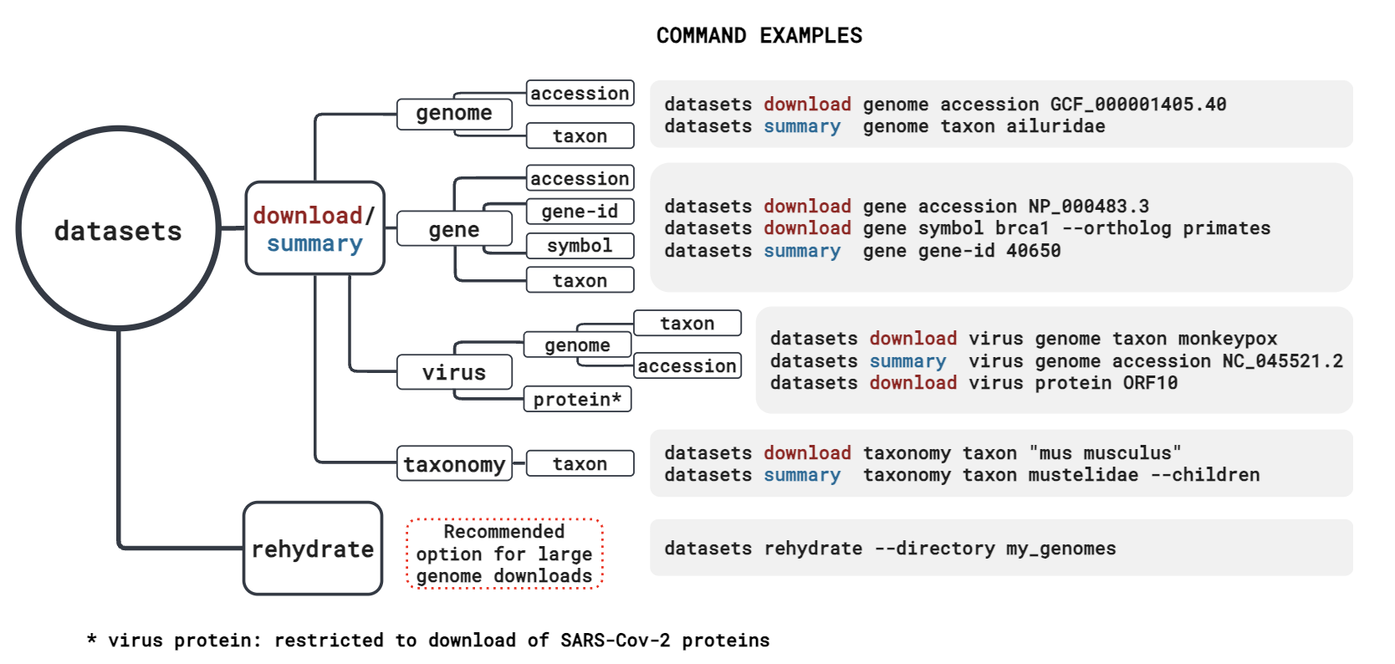
Obtaining data from NCBI
Instructionsto use datasets: Lab 3
KAUST Bioinformatics Platform

Slide 9
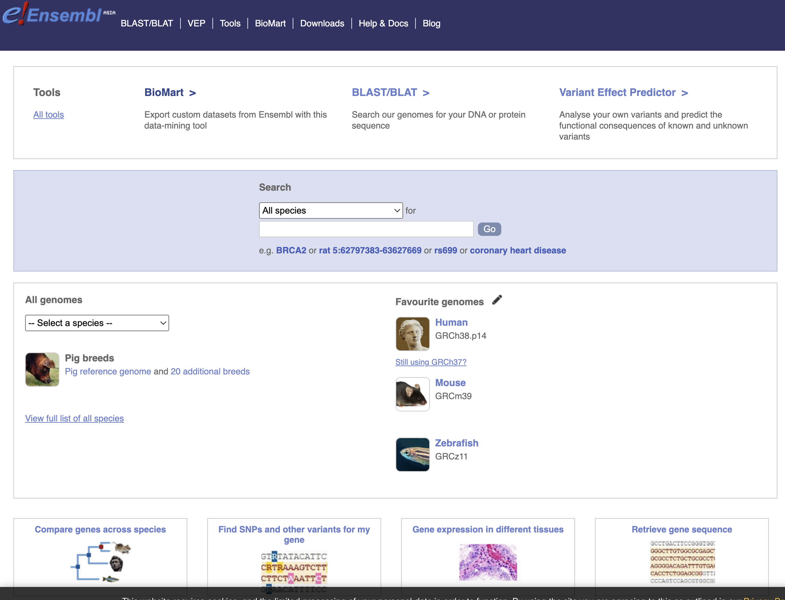
Ensembl: https://ensembl.org?redirect=no

